Slide 1
Using the Debugger
Code Camp Week 5

Slide 2

What is the Debugger?
It is a utility used to test your code and look at the program’s execution
Allows you to put breakpoints, which stop the programs execution at a specific line of code
Lets you run the code line-by-line and look at all the variables at that point in execution

Slide 3
Assert Statements
Another method of debugging
Must include the library <cassert>
They are formatted as follows:
assert(<boolean expression>);
If the boolean expression is false, the program throws an exception and crashes
If the expression is true the program continues as normal

Slide 4
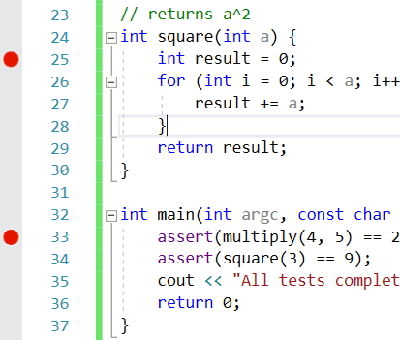
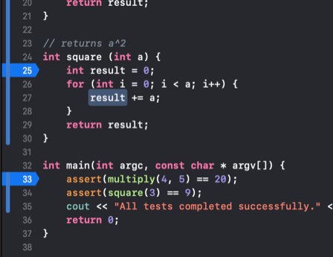
Making a Breakpoint
On Windows
On Mac
Tap this sidebar

Slide 5
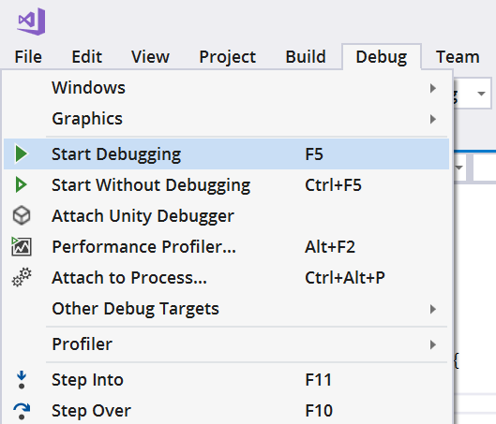
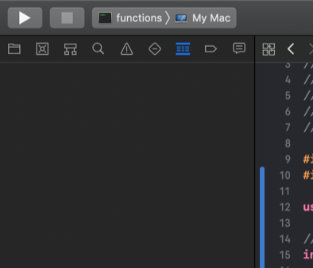
Starting the Debugging Session
On Windows
On Mac

Slide 6
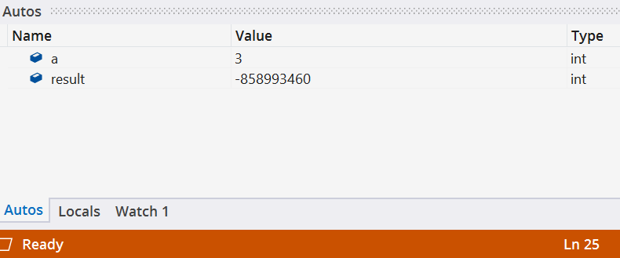
Variable Window
On Windows
On Mac

Slide 7
Methods of Traversing the Program
Step Into:
Goes into the function at the current line
Allows you to traverse the lines at the current function
Step Out:
Exits the current function, skipping the rest of the lines in the current function
Step Over:
Executes the current line and goes to the next line
If there is a function at the current line, it will just be skipped
Avoid traversing the lines inside some function

Slide 8
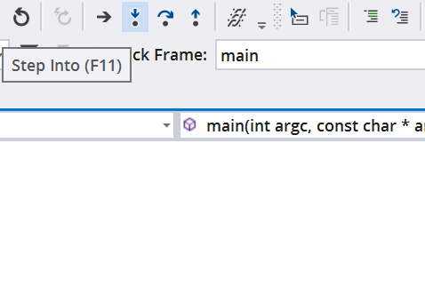
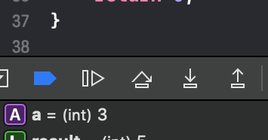
Step Into
On Windows
On Mac

Slide 9
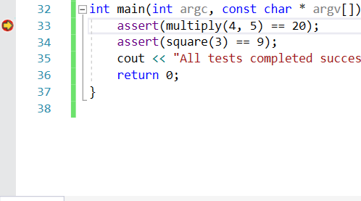
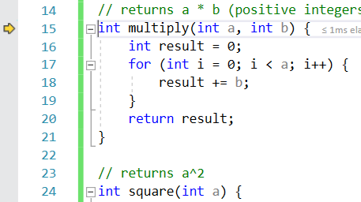
Step Into
Before Step Into
After Step Into

Slide 10
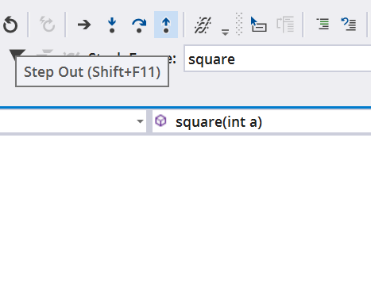
Step Out
On Windows
On Mac

Slide 11
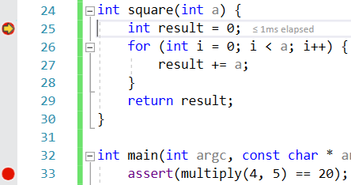
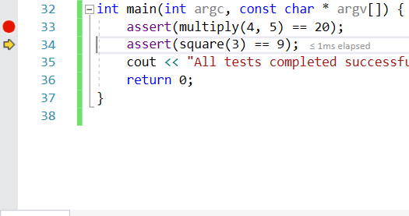
Step Out
Before Step Out
After Step Out

Slide 12
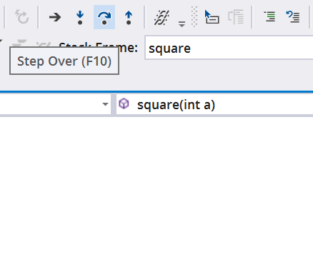
Step Over
On Windows
On Mac

Slide 13
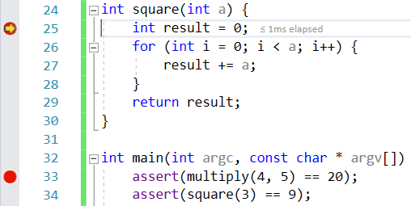
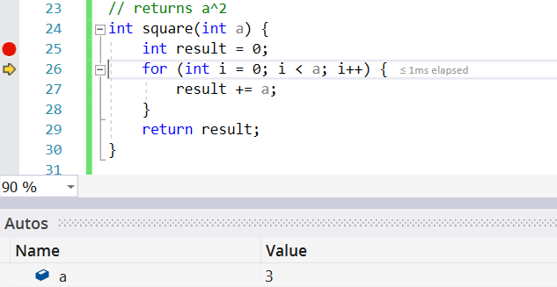
Step Over
Before Step Over
After Step Over

